Slide 1
ANUDIP PRESENTATION
D.SRUJAN KUMAR
P.TEJASWI
KEERTHANA
V.SUSHMITHA
SATHWIK

Slide 2
PART - 1 TASK 1
HOW MUCH IS SPENT FOR EACH CATEGORY(PIVOT TABLE)
VISUALLY REPRESENT THE AMOUNT SPENT AGAINST EACH CATEGORY IS WHAT PERCENTAGE OF THE TOTAL EXPENSE AMOUNT (PIVOT CHART)

Slide 3
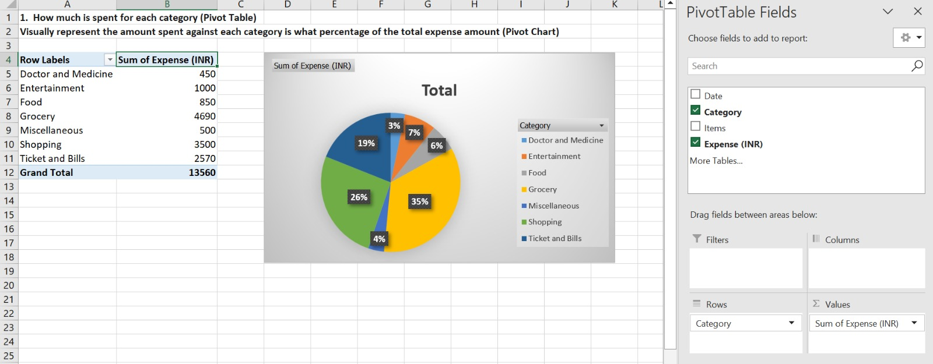

Slide 4
TASK 2
HOW MUCH IS SPENT ON DIFFEREN ITEMS OF EACH CATEGORY ( PIVOT TABLE )
VISUALLY REPRESENT ON THE AMOUNT SPENT ON DIFFERENT ITEMS OF ENTERTAINMENT AND TICKETS & BILLS CATEGORY ( PIVOT CHART )

Slide 5
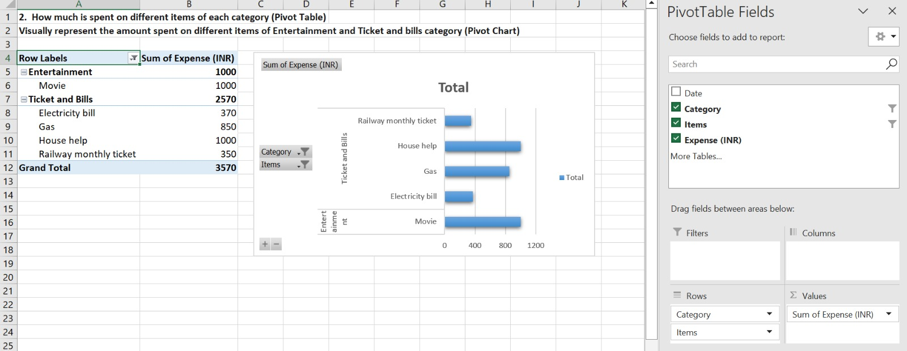

Slide 6
TASK 3
HOW MANY TIMES MONEY HAS BEEN SPENT AGAINST DIFFERENT ITEMS ON EACH CATEGORY ( PIVOT TABLE )
FILTER THE DATA TO DISPLAY THE DATA FOR GROCERY ITEMS AND SHOPPING ITEMS

Slide 7
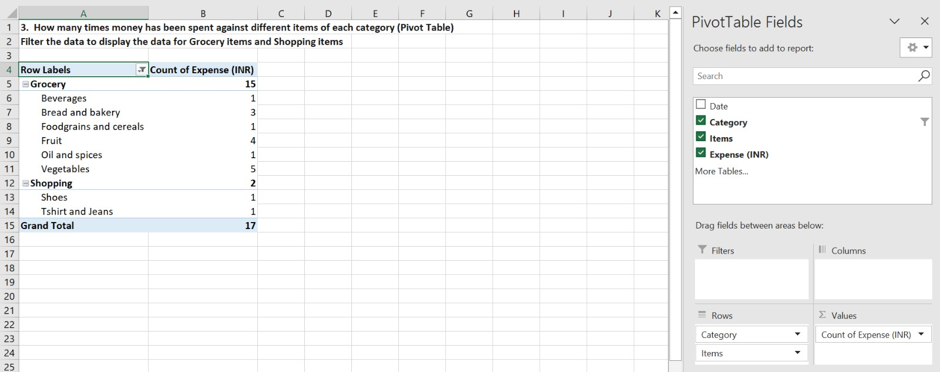

Slide 8
TASK 4
WHAT AMOUNT IS SPENT ON EACH ITEM OF THE CATEGORIES WITH HIGHEST AND 2ND HIGHEST EXPENSE AMOUNT ( PIVOT TABLE )
VISUALLY REPRESENT THE DATA WITH DATA BARS

Slide 9
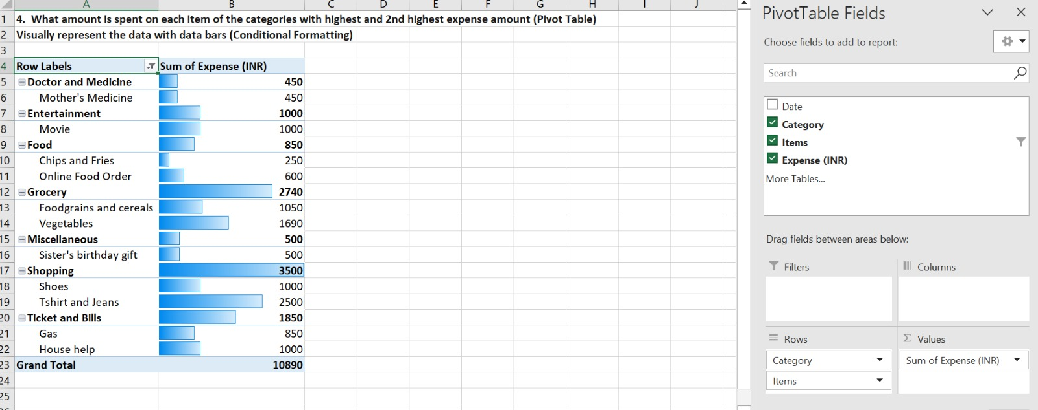

Slide 10
PART - 2 TASK 1
MONTH-WISE TREND OF EXPENSES ( PIVOT TABLR & PIVOT-CHART )
FIND OUT THE MONTH NITIN SPENT THE MOST

Slide 11
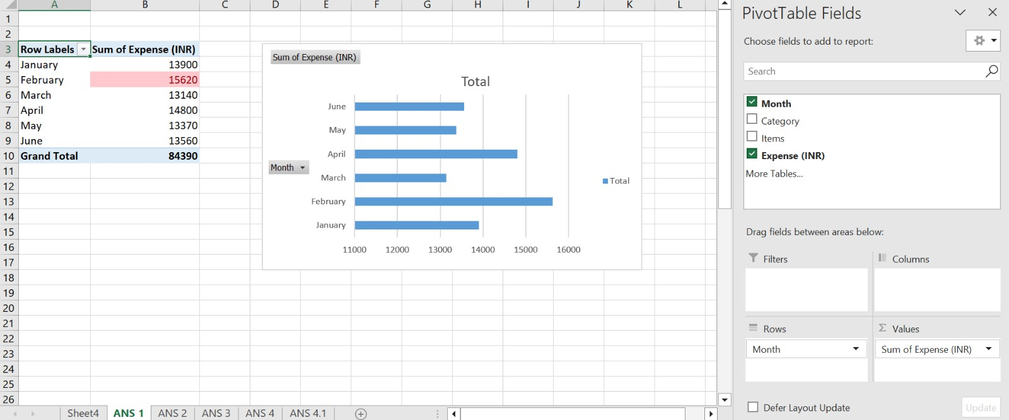

Slide 12
TASK 2
CATEGORY WISE EXPENSES ( PIVOT-TABLE & PIVOT-CHART )
VISUALLY REPRESENT WITH THE DATA BARS TO DISPLAY CATEGORIES WITH THE HIGHEST AND LOWEST AMOUNT

Slide 13
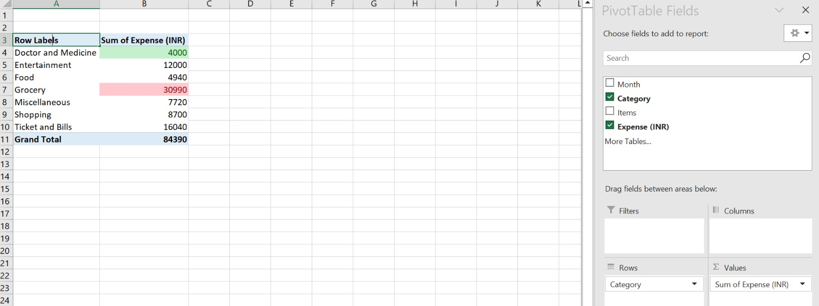

Slide 14
TASK 3
MONTH-WISE EXPENSE OF EACH CATEGORY (PIVOT-TABLE )
FIND OUT 2 CATEGORIES WITH HIGHER EXPENSES FOR EACH OF THE 6 MONTHS

Slide 15
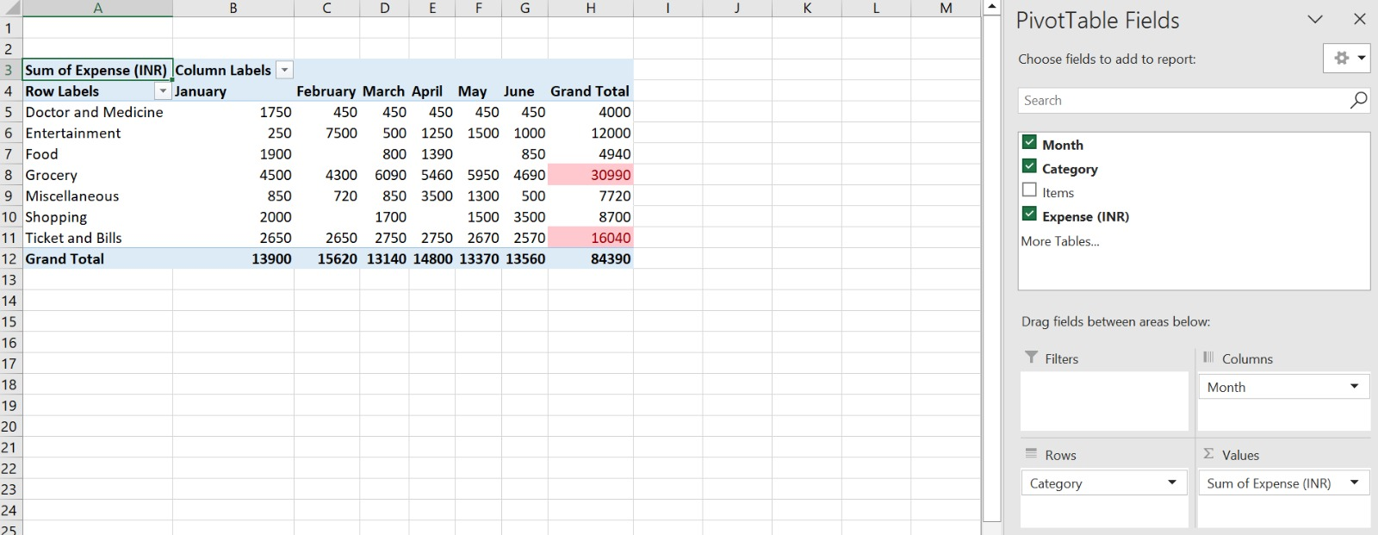

Slide 16
TASK 4.1
HOW MUCH IS SPENT IN EACH MONTH AGAINST DIFFERENT ITEMS OF ENTERTAINMENT, FOOD AND SHOPPING CATEGORIES ( PIVOT TABLE)

Slide 17
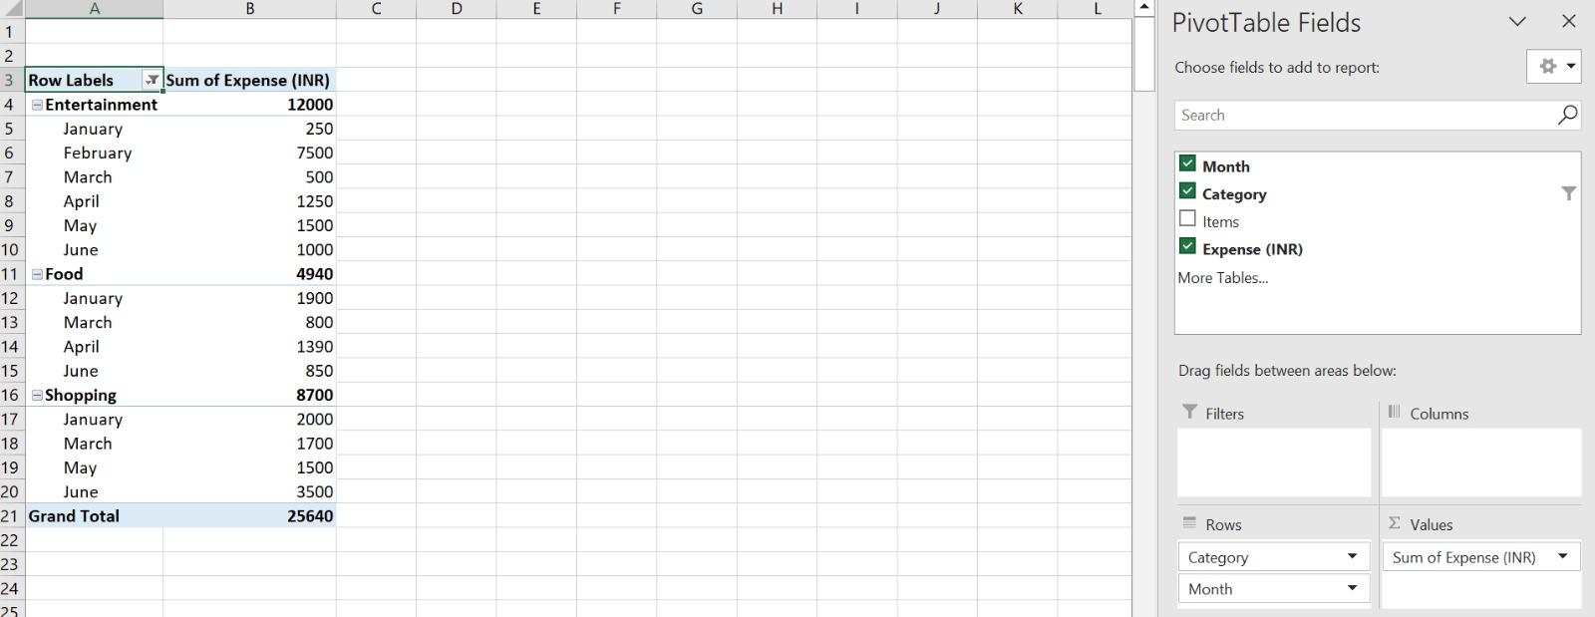

Slide 18
TASK 4.2
FIND OUT WHICH MONTHS HAVE THE HIGHEST AMOUNT SPENT FOR MOVIES AND DINING OUT

Slide 19
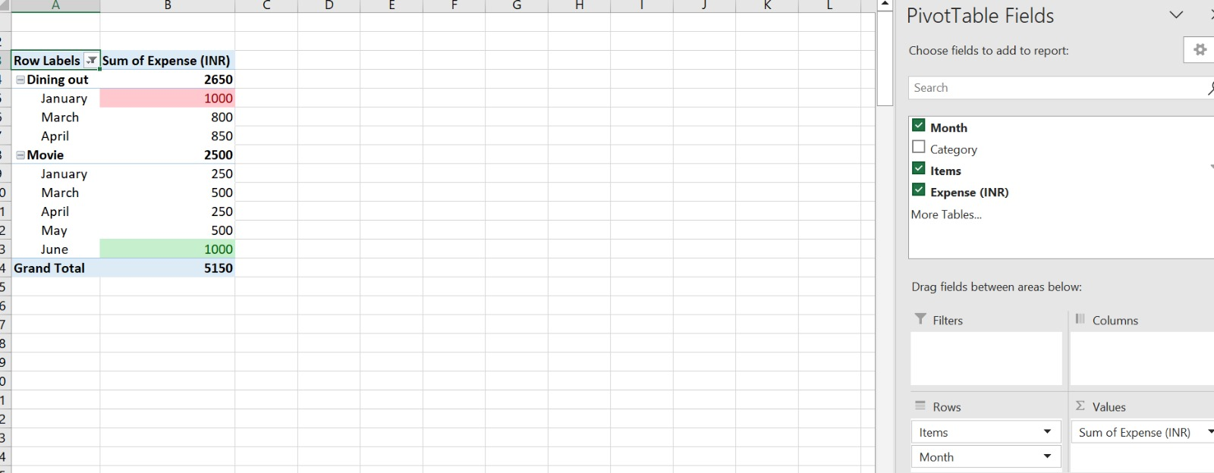

Slide 20
TASK 5.1
ESSENTIAL ITEMS:
MEDICINE
VEGETABLES & FRUITS
OTHER ESSENTIAL ITEMS

Slide 21
LESS ESSENTIAL ITEMS:
ONLINE SHOPPING
FISH & CHICKEN
GIFTS
ORDERING FOOD
MOVIE WITH FRIENDS
TRIP

Slide 22
TASK 5.2
RECOMMEND HOW CAN NITIN INCREASE HIS SAVINGS
RECOMMENDATIONS:
SPENDING A CONSIDERABLE AMOUNT WHILE ORDERING FOOD AND SHOPPING OR INSTEAD CHOOSING A DISCOUNTED OPTIONS.
USING ANY BUDGETING APPS LIKE EXCEL TO ANALYSE AND DECREASE THE SPENDING ON NON-ESSENTIAL ITEMS
NOT SPENDING TOO MUCH ON SHOPPING AND NON-ESSENTIAL ITEMS WHICH MAY INCREASE THE EXPENSES.

Slide 23
THANK YOU

